Slide 1
System Development Methods CT00046-3-2
System Analysis – Part 2

Slide 2
Topic & Structure of the Lesson
System analysis techniques and tools
System analysis benefits and setbacks

Slide 3
Learning Outcome
At the end of the module, you should be able to:
Explain the various system analysis techniques and tools.
Describe system analysis benefits and setbacks.

Slide 4
Key Terms you must be able to use
If you have mastered this topic, you should be able to use the following terms correctly in your assignments and exams:
System analysis techniques and tools.
System analysis benefits and setbacks

Slide 5
System analysis techniques and tools

Slide 6
Quantitative vs Qualitative Research and Analysis
In general, research and analysis use quantitative and/or qualitative data.
Quantitative
Associated with numerical analysis where data is collected, classified, and then computed.
Data is chosen randomly in large samples and then analyzed.
Use of structured data - highly organized and easily understood by machine language.
Qualitative
Involving an interpretation to its subject matter.
Study things in their natural settings, attempting to make sense of, or interpret phenomena.
Qualitative data is descriptive which can be observed but not measured.

Slide 7
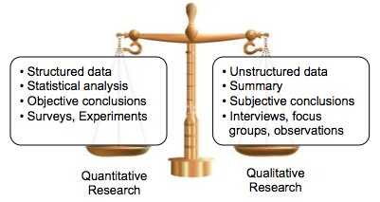
Quantitative vs Qualitative Research and Analysis

Slide 8
System Analysis Techniques
Project Analysis
Business Intelligence Analysis
Data Mining Analysis
Statistical Analysis

Slide 9
System Analysis Techniques Project Analysis
Analysis of factors influencing the project. Used by project managers to plan large / multiple projects. Tools enable to analyze and determine the most efficient use of resources, examples:
Financial Analysis explains how to use three main cost analysis: payback analysis, return on investment (ROI), and net present value (NPV).
Payback analysis determines how long it takes an information system to pay for itself through reduced costs and increased benefits.
Return on investment (ROI) is a percentage rate that compares the total net benefits (the return) received from a project to the total costs (the investment) of the project.
The net present value (NPV) of a project is the total value of the benefits minus the total value of the costs, with both costs and benefits adjusted to reflect the point in time at which they occur.
Risk Analysis to identify risks and develop acceptable resolutions.

Slide 10

System Analysis Techniques Business Intelligence Analysis
Business intelligence analysis relies heavily on aggregation, focusing on business information.
Using business analysis techniques to find benefits of data to the business.
Approach:
Seeking product / service opportunities, examples: SWOT analysis, Fishbone analysis, PEST analysis, etc.
Output:
Clearer information for business decisions.

Slide 11
SWOT Analysis
A SWOT analysis stands for strengths, weaknesses, opportunities, and threats. A SWOT analysis usually starts with a broad overview. The first step is for top management to respond to questions like these:
What are our strengths, and how can we use them to achieve our business goals?
What are our weaknesses, and how can we reduce or eliminate them?
What are our opportunities, and how do we plan to take advantage of them?
What are our threats, and how can we assess, manage, and respond to the possible risks?
Sample of typical strengths, weaknesses,
opportunities, and threats.

Slide 12
Fishbone Analysis
Fishbone is an analysis that represents the possible causes of a problem as a graphical outline. An analyst first states the problem and draws a main bone with sub-bones that represent possible causes of the problem.
For example, the problem is unhappy workers, and the analyst has identified four areas to investigate: environment, workers, management, and machines.
In each area, the analyst identifies possible causes and draws them as horizontal sub-bones.

Slide 13
Fishbone Analysis
(continued)
For example, too hot is a possible cause in the environment bone. For each cause, the analyst must dig deeper and ask the question:
What could be causing this symptom to occur? Why is it too hot?
If the answer is insufficient air conditioning capacity, the analyst indicates this as a sub-bone to the too hot cause. In this manner, the analyst adds additional sub-bones to the diagram, until he or she uncovers root causes of a problem, rather than just the symptoms.
Sample of fishbone analysis

Slide 14
Watch the following video about PEST analysis that helps to understand macro external factors in a business.
https://www.youtube.com/watch?v=gZ0FVeReXd8&ab_channel=LeanVlog

Slide 15
System Analysis Techniques Data Mining Analysis
Digging through a large amount of data to find relevant / logical information / relationships. (aka Data Analytics)
Popular Data Mining techniques include Correlation, aggregation, regression, associations, etc.
Focuses on modeling and knowledge discovery for “predictive analysis”.
Output of data mining:
Quantitative and Qualitative presented in tabular or visual form.

Slide 16
System Analysis Techniques Data Mining Analysis (continued)
Data Mining Analysis Examples:
Aggregation: to get more information about specific groups based on specific variables such as age, profession, or income.
Example: a car class can be defined to contain other classes such as engine class, seat class, wheels class etc.
Regression: to identify the likelihood of a certain variable, given the presence of other variables.
Example: you could use it to project a certain price, based on other factors like availability, consumer demand, and competition.

Slide 17
System Analysis Techniques Data Mining Analysis (continued)
Association: related to tracking patterns, look for specific events or attributes that are highly correlated with another event or attribute.
Example: you might notice that when your customers buy a specific item, they also often buy a second, related item. This could help in product inventory management.
Clustering: grouping chunks of data together based on their similarities.
Example: to cluster different demographics of your audience into different packets based on the income they have, or how often they tend to shop at your store.
Prediction: recognizing and understanding historical trends to predict what will happen in the future.
Example: study review consumers’ credit histories and past purchases to predict whether they’ll be a credit risk in the future.

Slide 18
Popular System Analysis Techniques Statistical Analysis
Using numeric data to find/predict data relationships.
Popular Statistical Analysis techniques:
Statistical summary: Min, Median, Mode, Comparison, etc.
Correlation analysis: to evaluate the strength of the relationship between two / more quantitative variables, taller people tend to be heavier.
Focuses on calculating statistics of events, examples:
Study of the stock market, sales, weather based on the previous record.
The reaction of various drugs on cancer patients.
Output: Quantitative data used for prediction/forecasting and confirmation of facts.

Slide 19
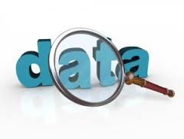
System Analysis Tools
Tools used to collect, store, inspect, cleanse, transform, modeling and present data in a useful manner.
Advantages
Fast and accurate
Present data in various forms for better understanding.
Help to create better product/service for users
Disadvantages
Analysis techniques are many and often confusing
Need specific format of data for input
Some tools are expensive

Slide 20
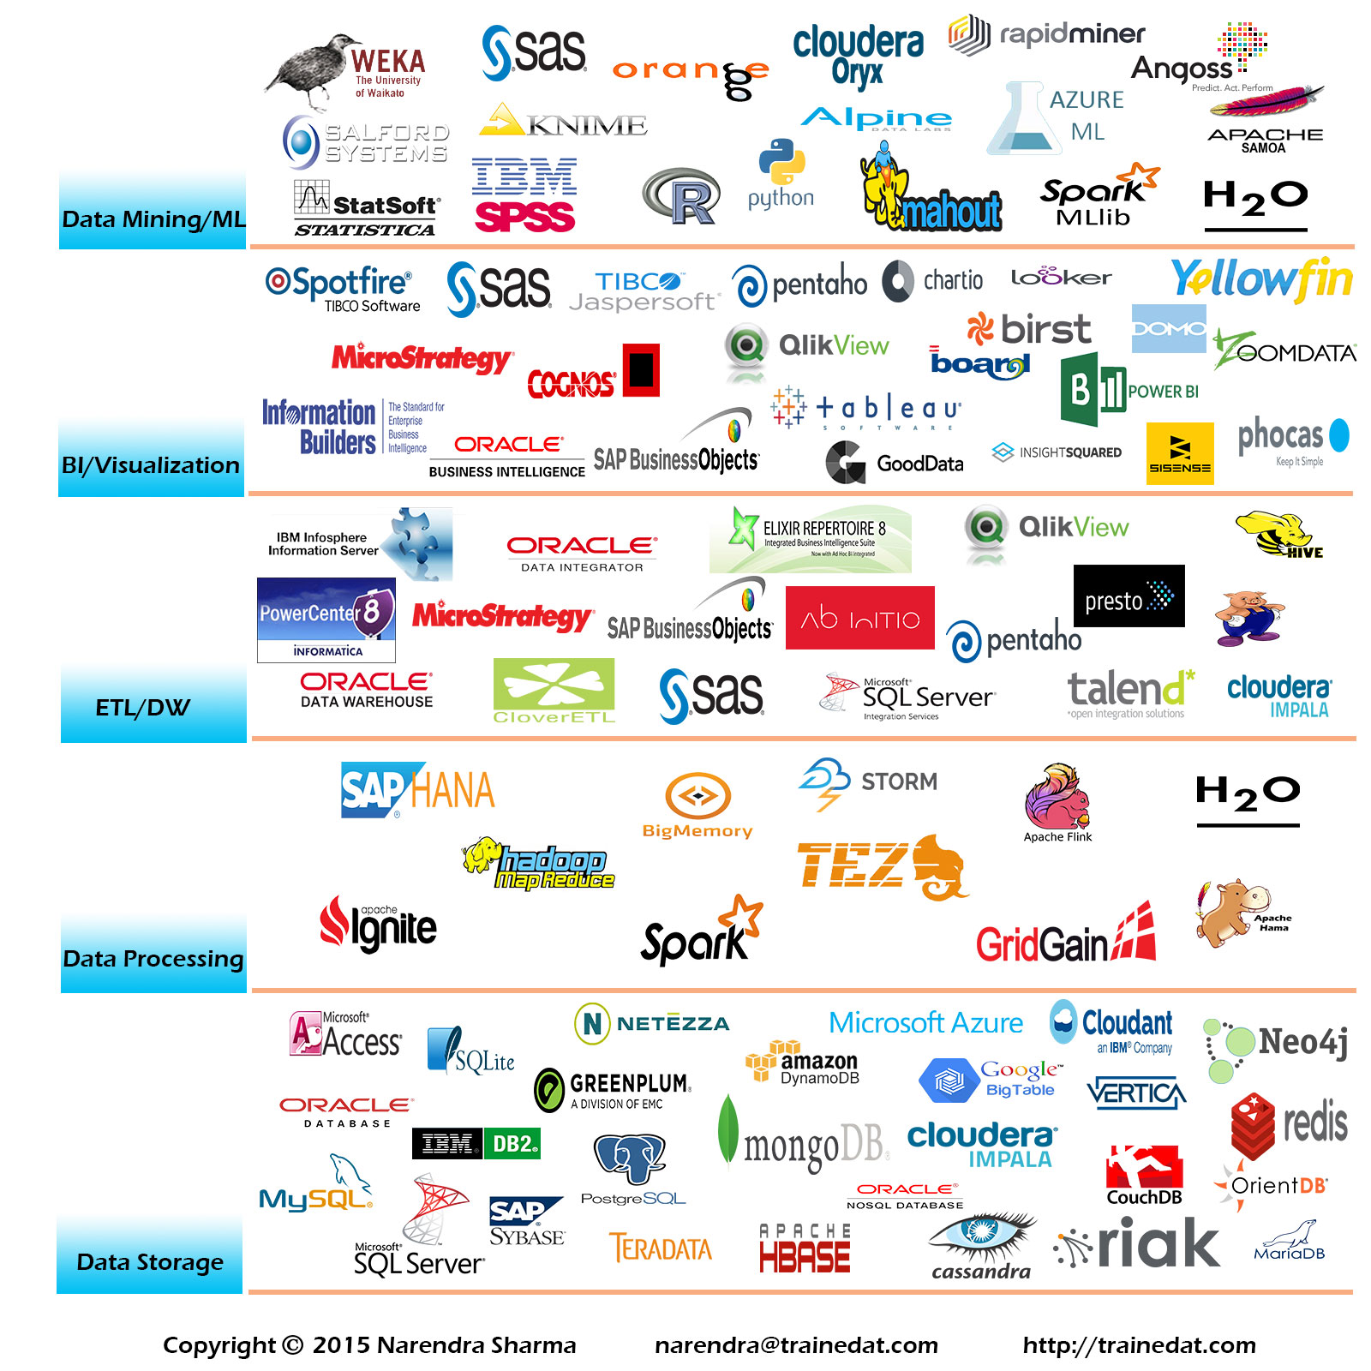
Popular System Analysis Tools

Slide 21
System analysis benefits and setbacks

Slide 22

Benefits of System Analysis
Knowledge discovery
Problem's source / cause discovery
Obtain proof to support a theory
Verify assumptions with real facts
Filter and keep only important/relevant data
See the relationship between facts and figures
View data in a different way to obtain ideas

Slide 23
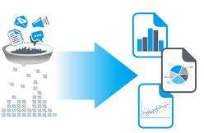
Setbacks of System Analysis
Insufficient data collected
Unreliable and invalid data
Incorrect analysis methods used
Difficult to use analysis tools
Lack of scope / objective of output
Biased inference – leads to inaccurate facts/recommendations.
Analyst (architect) - lack analysis skills
External issues / hindrance

Slide 24
Summary
Quantitative research is associated with numerical analysis where data is collected, classified, and then computed. Whilst qualitative research is descriptive which can be observed but not measured.
Project analysis helps to analyse factors influencing the project.
The business analysis focuses on business information by identifying the causes of the problem, strengths, weaknesses, opportunities, and threats of a business.
Data mining analysis helps to dig through a large amount of data to find relevant / logical information/relationships.
Statistical analysis using numeric data to find/predict data relationships and confirmation of facts.

Slide 25
Question & Answer

Slide 26
Next Session
System Design

